Slide 1
Arduino for beginners
Zero to hero

Slide 2
Arduino specification
Microcontroller | ATmega328P – 8 bit AVR family microcontroller
Input Voltage Limits | 6-20V
Analog Input Pins | 6 (A0 – A5)
Digital I/O Pins | 14 (Out of which 6 provide PWM output)
DC Current on I/O Pins | 40 mA

Slide 3
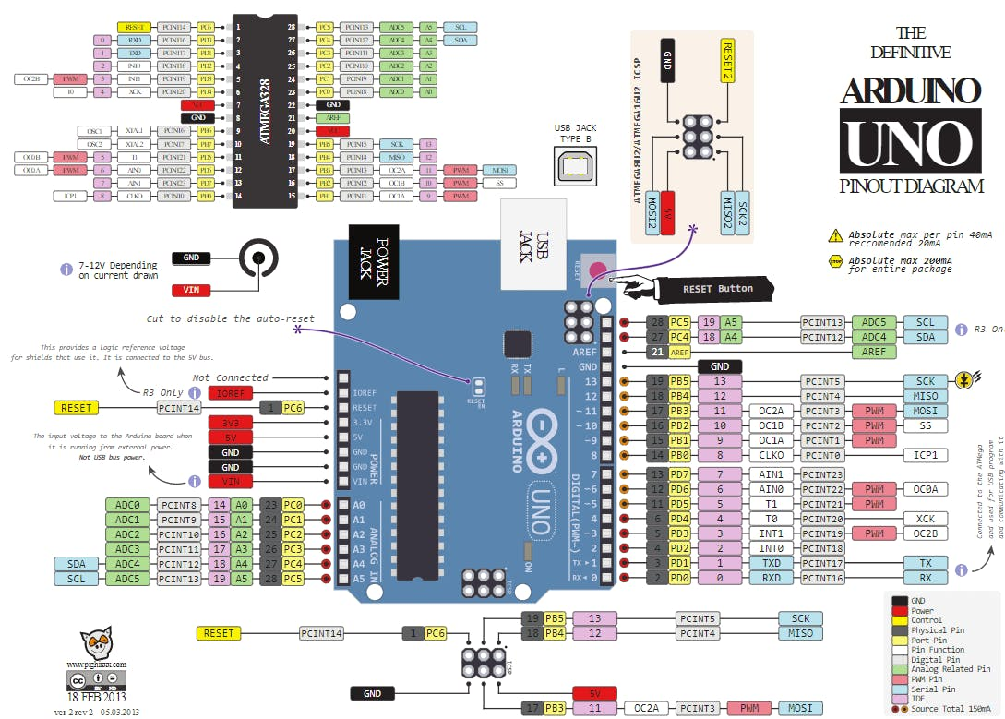
Arduino pinout

Slide 4
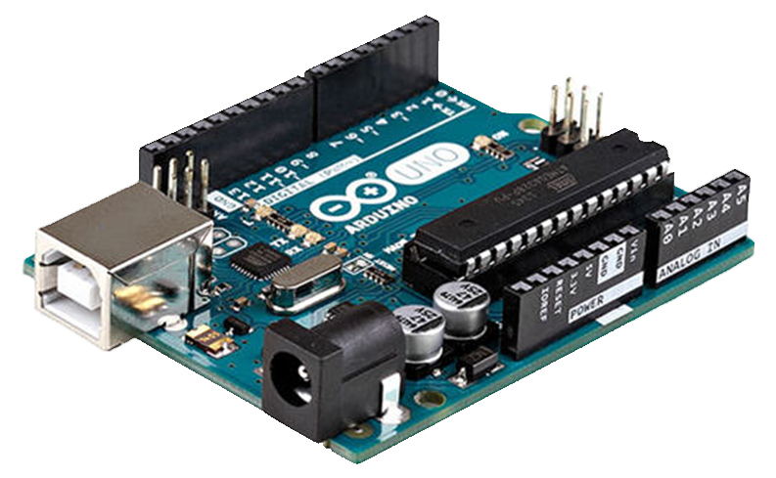
Arduino board

Slide 5
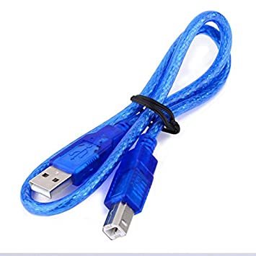
Arduino USB connector

Slide 6
Programing language for Arduino
Arduino support c and c++.
You can use python for program a Arduino.

Slide 7
Software for program Arduino
I use Arduino IDE.
For startup Arduino IDE is best option.
If you like VScode. You can use.

Slide 8
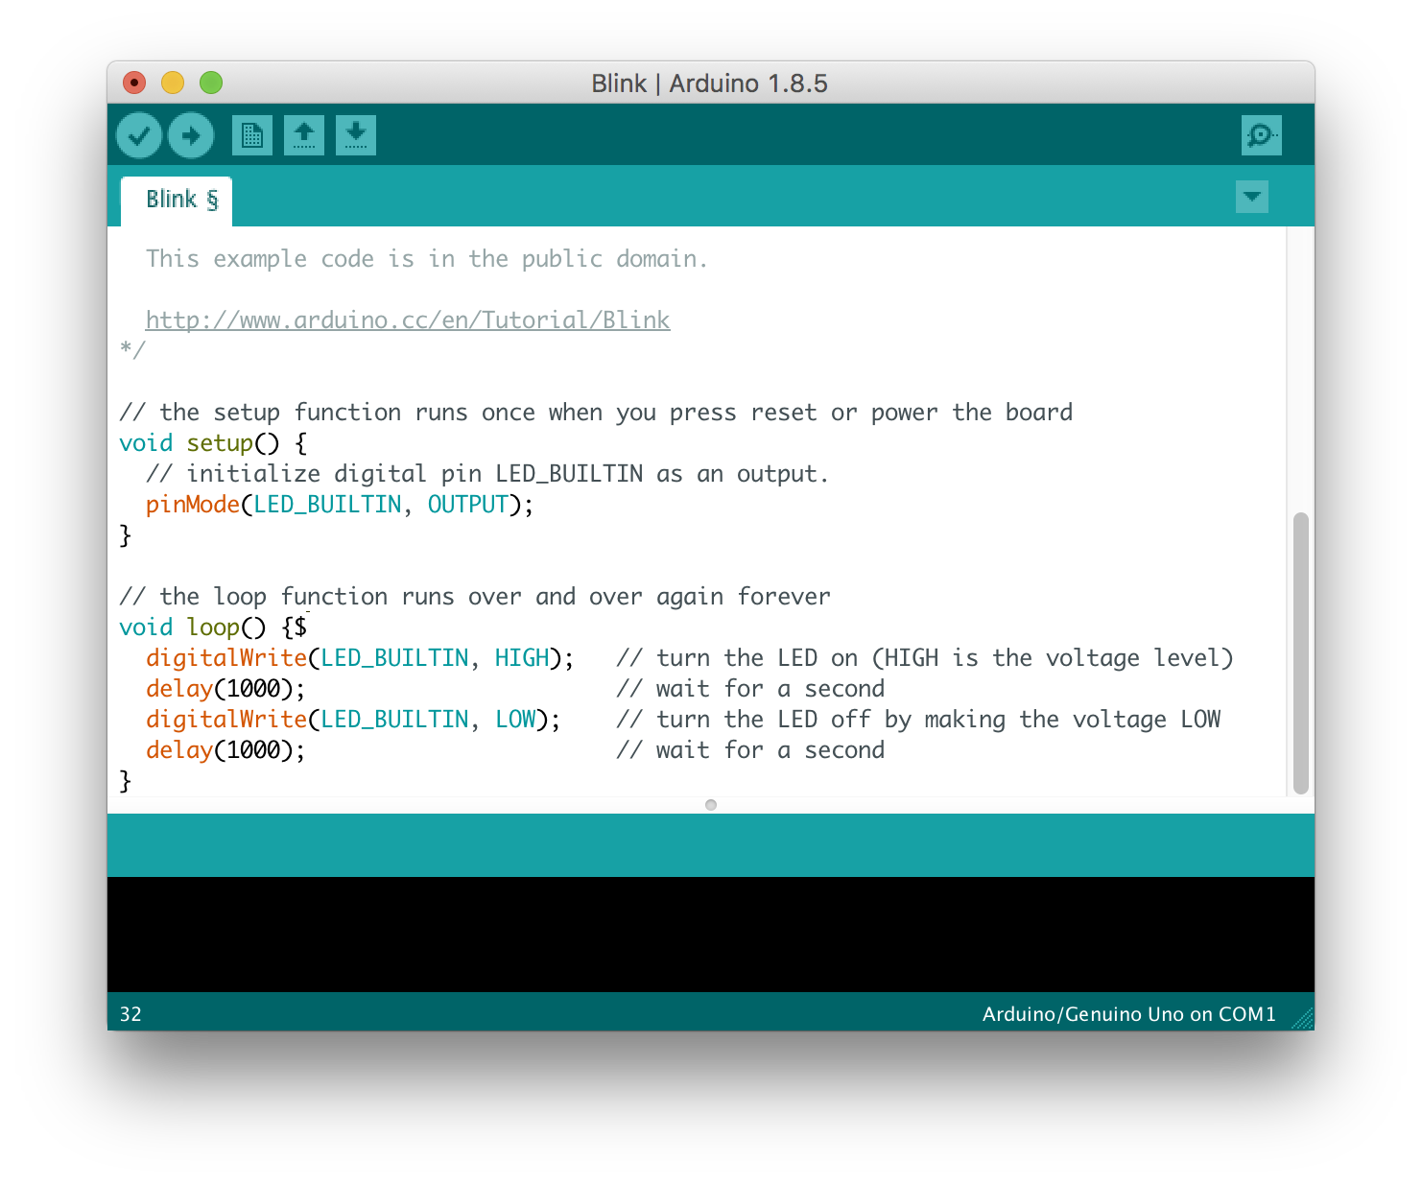
Arduino IDE

Slide 9
Install Arduino ide
Arduino ide download
https://www.arduino.cc/en/software

Slide 10
Connect Arduino with pc.
Find the com_port.
Example
COM0, COM3, COM12,etc.

Slide 11
Basic template
//declear all pin and variable
void setup(){
//pin_init INPUT and OUTPUT
}
void loop(){
//main loop
}
Arduino file is .ino file.

Slide 12
Variable type
Int ,float ,boolean ,long ,etc.

Slide 13
Int (Integers )
Integers are your primary data-type for number storage.
Integers is 16-bit (2-byte) value variable.
Example
Int LED=13;
const int LED=10;

Slide 14
Char (character)
The size is one-byte (8 bit) .
Use ASCII value for store the data.
ASCII value is 8bit or one-byte.
Example
char data=r;

Slide 15
ASCII - Binary Character Table
Letter | ASCII Code | Binary | Letter | ASCII Code | Binary
a | 097 | 01100001 | A | 065 | 01000001
b | 098 | 01100010 | B | 066 | 01000010
c | 099 | 01100011 | C | 067 | 01000011
d | 100 | 01100100 | D | 068 | 01000100
e | 101 | 01100101 | E | 069 | 01000101
f | 102 | 01100110 | F | 070 | 01000110
g | 103 | 01100111 | G | 071 | 01000111
h | 104 | 01101000 | H | 072 | 01001000
i | 105 | 01101001 | I | 073 | 01001001
j | 106 | 01101010 | J | 074 | 01001010
k | 107 | 01101011 | K | 075 | 01001011
l | 108 | 01101100 | L | 076 | 01001100
m | 109 | 01101101 | M | 077 | 01001101
n | 110 | 01101110 | N | 078 | 01001110
o | 111 | 01101111 | O | 079 | 01001111
p | 112 | 01110000 | P | 080 | 01010000
q | 113 | 01110001 | Q | 081 | 01010001
r | 114 | 01110010 | R | 082 | 01010010
s | 115 | 01110011 | S | 083 | 01010011
t | 116 | 01110100 | T | 084 | 01010100
u | 117 | 01110101 | U | 085 | 01010101
v | 118 | 01110110 | V | 086 | 01010110
w | 119 | 01110111 | W | 087 | 01010111
x | 120 | 01111000 | X | 088 | 01011000
y | 121 | 01111001 | Y | 089 | 01011001
z | 122 | 01111010 | Z | 090 | 01011010

Slide 16
Float value
They are stored as 32 bits (4 bytes) of information.
Example
float b=567.980;

Slide 17
Boolean
A boolean holds one of two values, true or false.

Slide 18
long
Long data size is 32 bits (4 bytes).
Example
Iong r=33435.788;

Slide 19
Local variable and global variable
Int LED=13; //global variable
Void setup(){
Int a=40; //local variable
}

